Slide 1
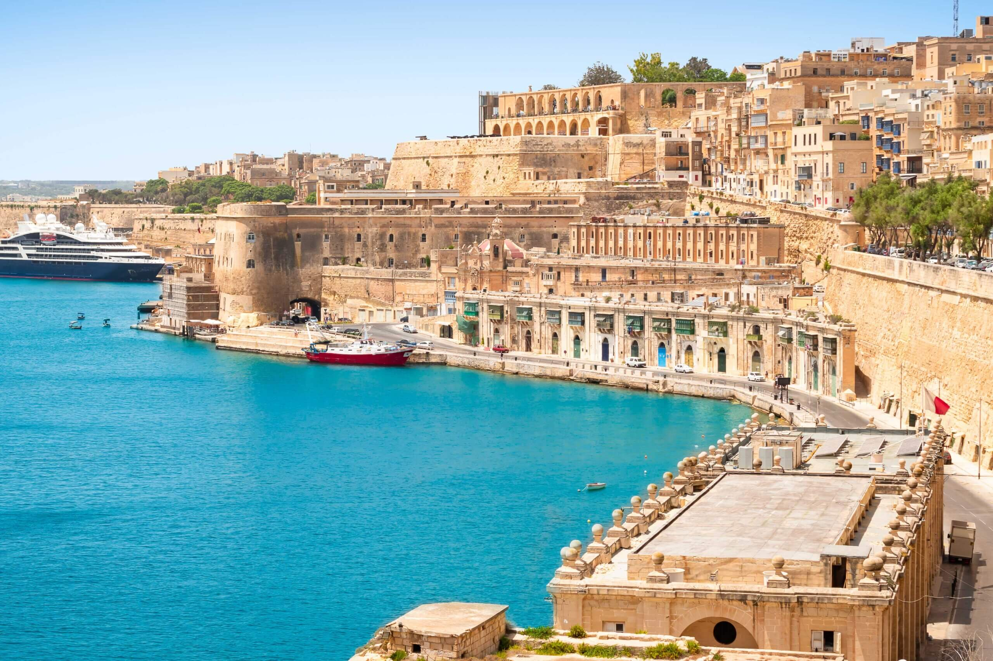
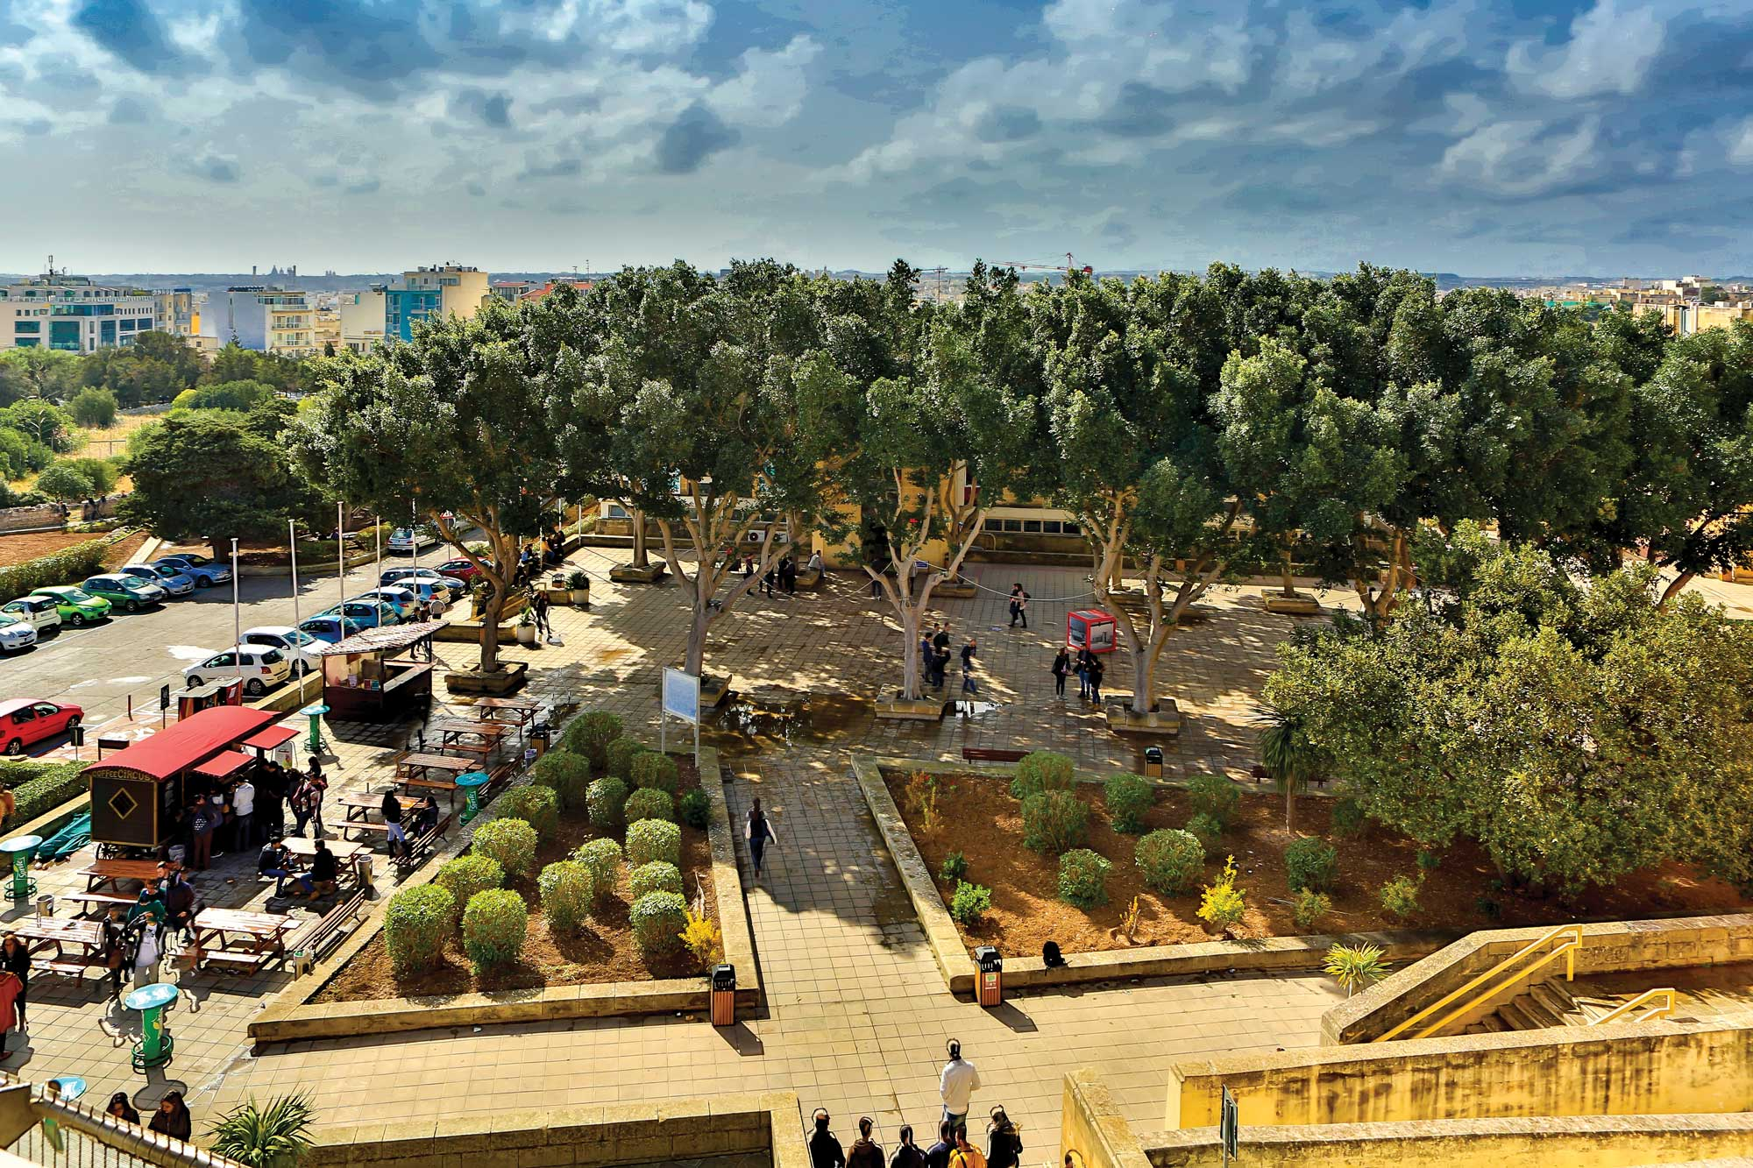
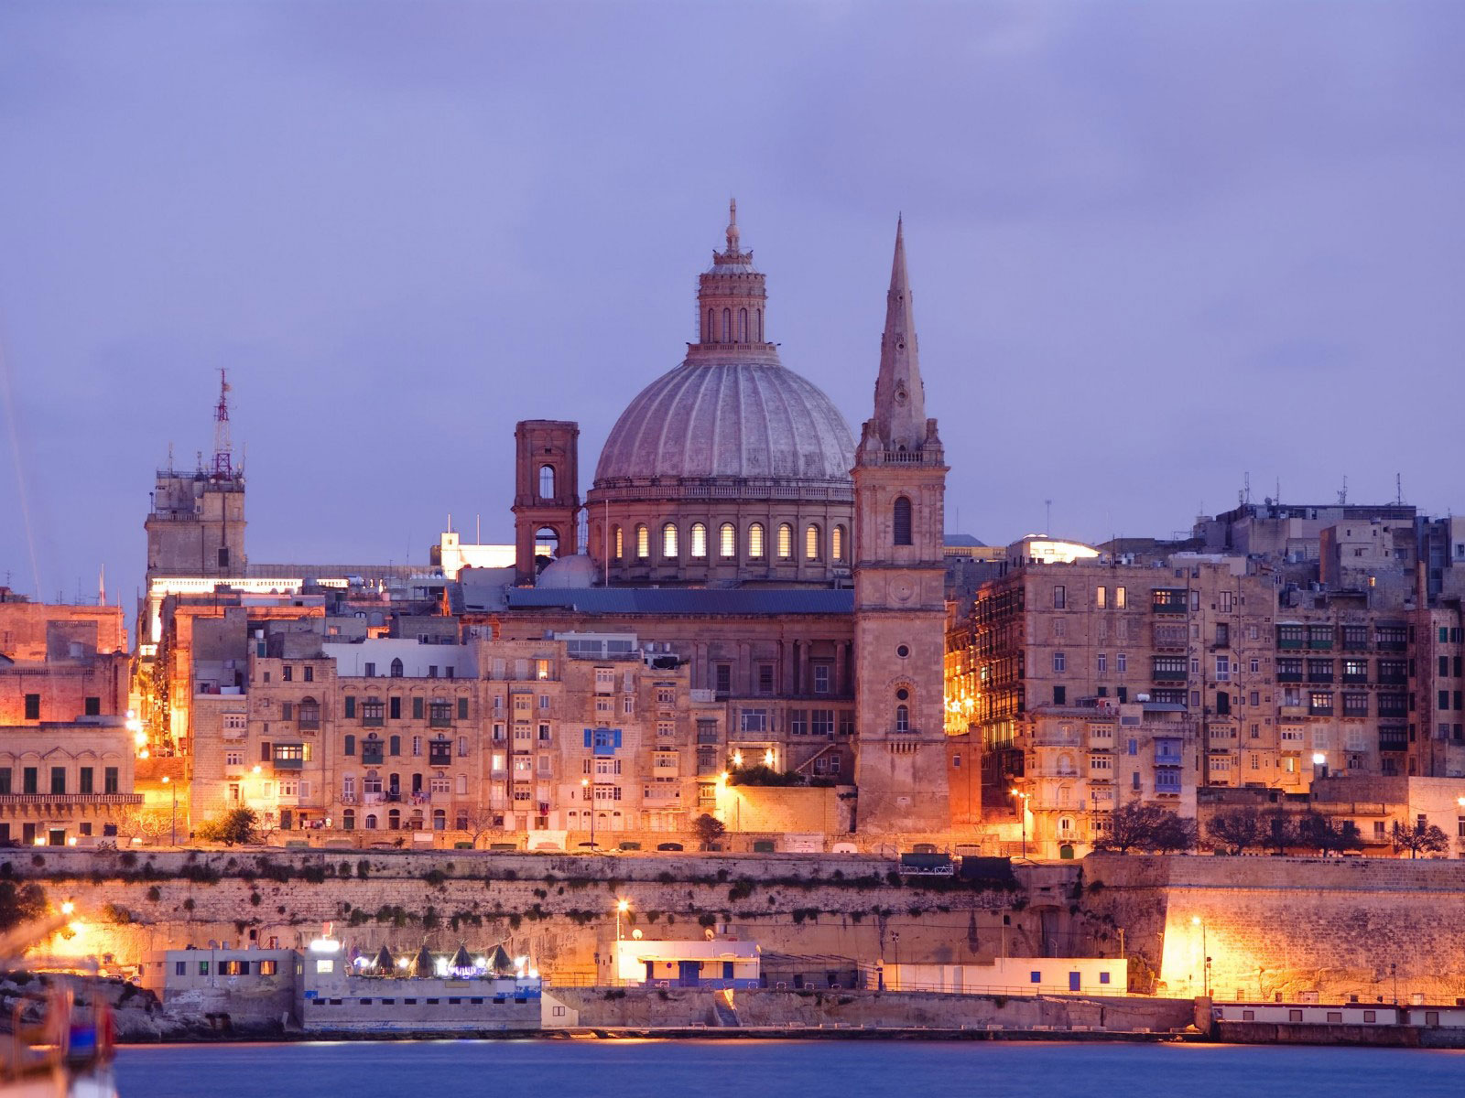


MALTAomics Summer School
From Multi-omics to Machine Learning
Panagiotis Alexiou
ERA Chair,
Bioinformatics for Genomics in Malta
(BioGeMT)

Slide 2






MALTAomics Summer School
From Multi-omics to Machine Learning

Slide 3

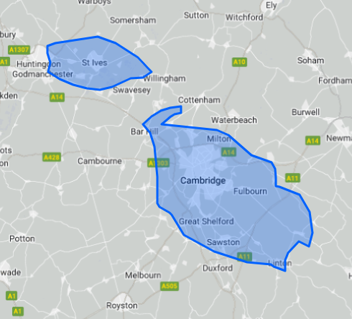
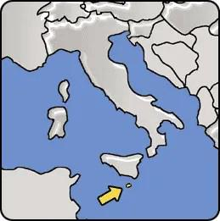
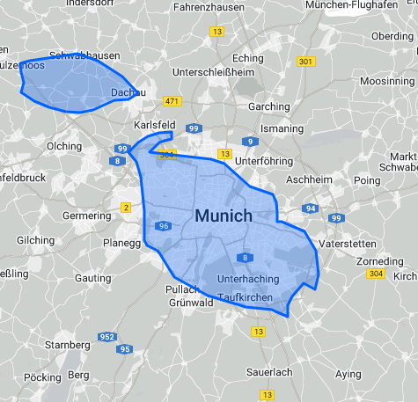

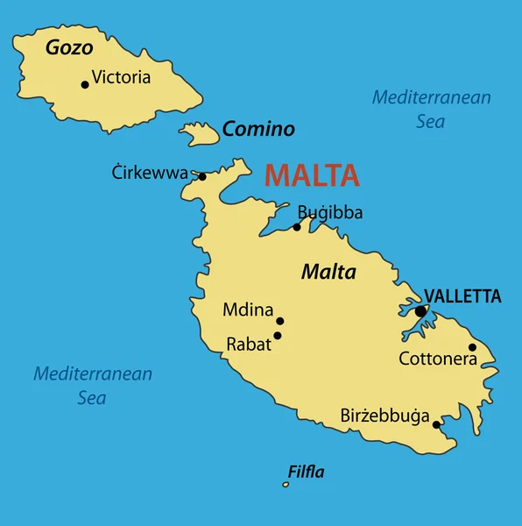
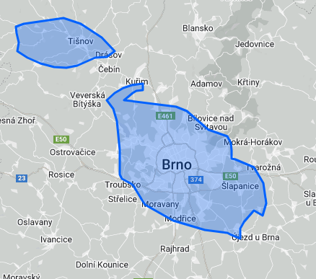
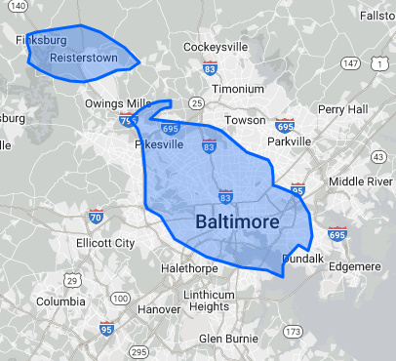

Slide 4
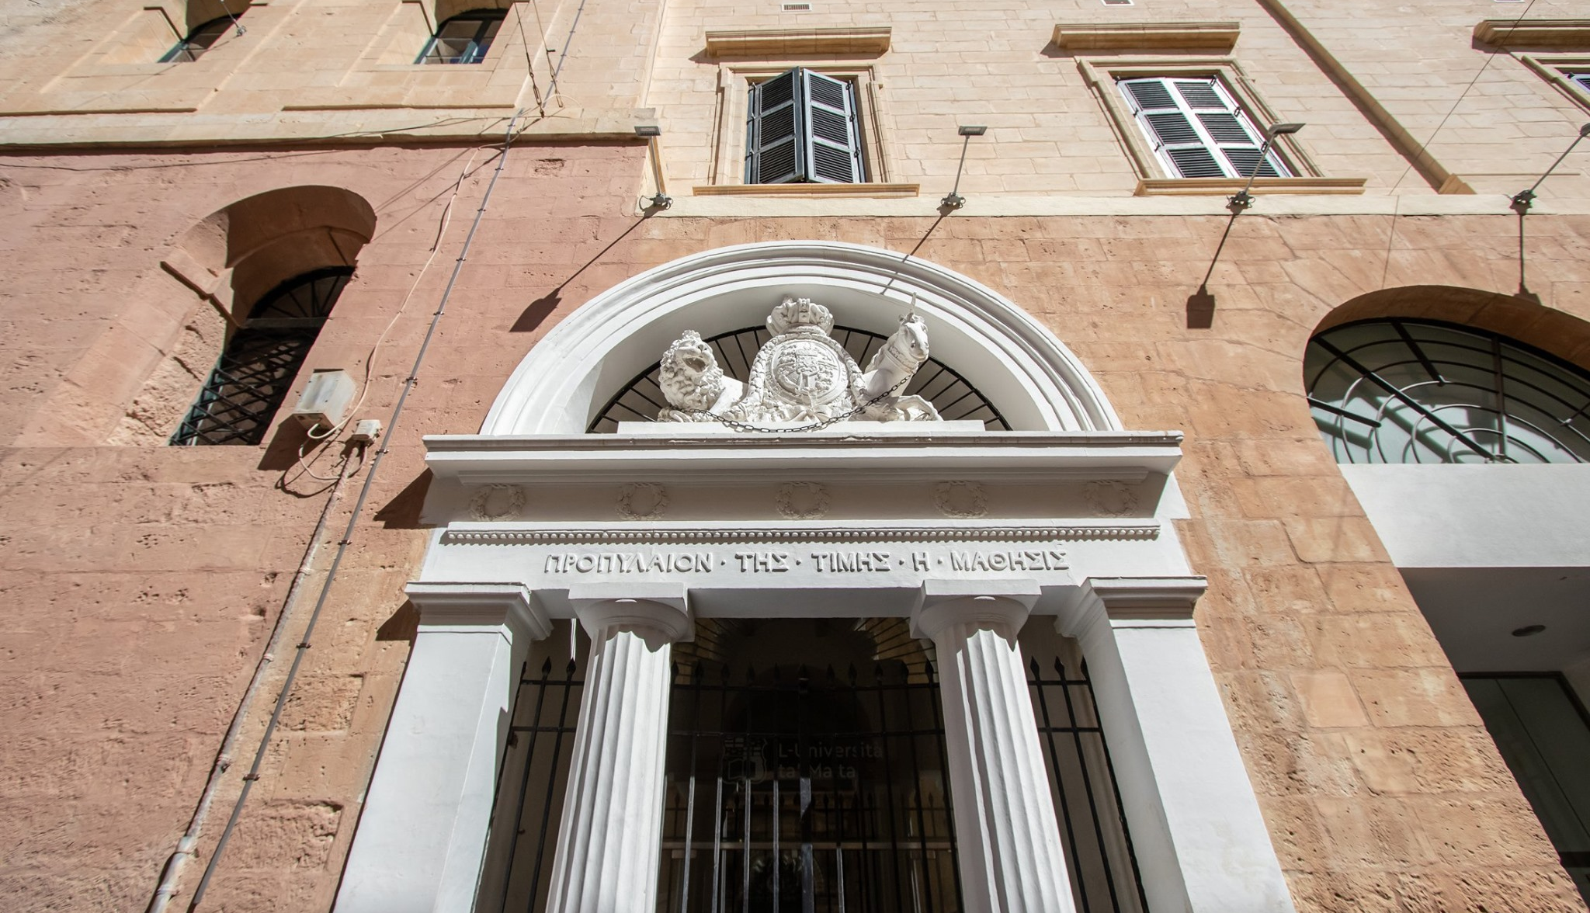

Established as College (1595) Became University (1769)
Today: Valletta Campus of UM

Slide 5






Goals of the MALTAomics Summer School
Increase
Knowledge in
ML and -omics
Expose to
Upcoming / SOTA
Technologies
Networking and
Community Building
MALTAomics Summer School

Slide 6
Goals of the MALTAomics Summer School
Increase
Knowledge in
ML and -omics
Expose to
Upcoming / SOTA
Technologies
Networking and
Community Building
Attendees will be able to develop basic ML workflows for –omics applications
Attendees will understand current state of the art in ML and perspectives for future development
Attendees will have opportunities to meet others with similar background and scientific interests
MALTAomics Summer School

Slide 7
MALTAomics Summer School
From Multi-omics to Machine Learning
09:00
Monday
Tuesday
Wednesday
Thursday
Friday
17:00
MALTAomics Summer School

Slide 8

MALTAomics Summer School
From Multi-omics to Machine Learning
09:00
Monday
Tuesday
Wednesday
Thursday
Friday
Browsing Genes and Genomes with Ensembl
17:00
MALTAomics Summer School

Slide 9

MALTAomics Summer School
From Multi-omics to Machine Learning
09:00
Monday
Tuesday
Wednesday
Thursday
Friday
Intro to Genomic Data
Browsing Genes and Genomes with Ensembl
Deep Learning for Genomics
Gene regulation discovery in the era of 3rd gen sequencing
CNNs for genomic annotation
17:00
MALTAomics Summer School

Slide 10

MALTAomics Summer School
From Multi-omics to Machine Learning
09:00
Monday
Tuesday
Tuesday
Wednesday
Thursday
Friday
Intro to Genomic Data
Intro to Transcriptomics
Browsing Genes and Genomes with Ensembl
Deep Learning for Genomics
Explainable Artificial Intelligence (XAI)
Gene regulation discovery in the era of 3rd gen sequencing
Explainability for Deep Neural Networks
CNNs for genomic annotation
17:00
MALTAomics Summer School

Slide 11

MALTAomics Summer School
From Multi-omics to Machine Learning
09:00
Monday
Tuesday
Tuesday
Wednesday
Wednesday
Thursday
Friday
Intro to Genomic Data
Intro to Transcriptomics
Computer Aided Drug Design
Browsing Genes and Genomes with Ensembl
Deep Learning for Genomics
Explainable Artificial Intelligence (XAI)
Molecular Representation and Random Forests
Gene regulation discovery in the era of 3rd gen sequencing
ML for Drug Discovery
Explainability for Deep Neural Networks
CNNs for genomic annotation
DL for Protein Structure
17:00
MALTAomics Summer School

Slide 12

MALTAomics Summer School
From Multi-omics to Machine Learning
09:00
Monday
Tuesday
Tuesday
Wednesday
Wednesday
Thursday
Friday
Intro to Genomic Data
Intro to Transcriptomics
Computer Aided Drug Design
Breakthroughs and Challenges in Multi-omics
Browsing Genes and Genomes with Ensembl
Deep Learning for Genomics
Explainable Artificial Intelligence (XAI)
Molecular Representation and Random Forests
Dissemination and Communication of Research
Gene regulation discovery in the era of 3rd gen sequencing
ML for Drug Discovery
Explainability for Deep Neural Networks
CNNs for genomic annotation
DL for Protein Structure
Round Table:
Biomedical Research and AI
17:00
MALTAomics Summer School

Slide 13


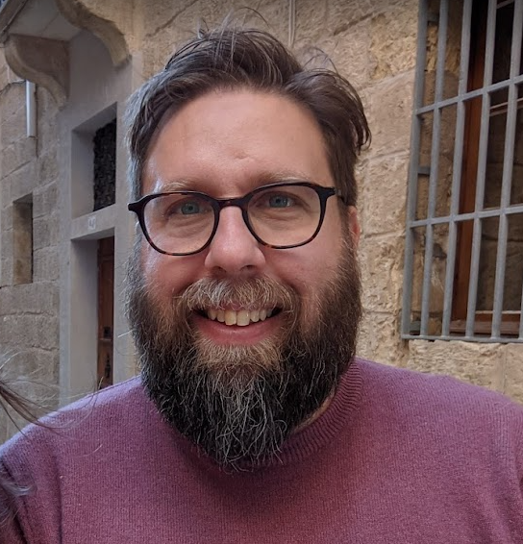

Monday
Tuesday
Tuesday
Wednesday
Wednesday
Thursday
Friday
Intro to Genomic Data
Intro to Transcriptomics
Computer Aided Drug Design
Breakthroughs and Challenges in Multi-omics
Browsing Genes and Genomes with Ensembl
Deep Learning for Genomics
Explainable Artificial Intelligence (XAI)
Molecular Representation and Random Forests
Dissemination and Communication of Research
Gene regulation discovery in the era of 3rd gen sequencing
ML for Drug Discovery
Explainability for Deep Neural Networks
CNNs for genomic annotation
DL for Protein Structure
Round Table:
Biomedical Research and AI
GitHub Repository
Panos Alexiou
panagiotis.alexiou@um.edu.mt
https://github.com/BioGeMT/MALTAomics-Summer-School

